Slide 1
Hero, Villain and Victim: Dissecting harmful memes for Semantic role labelling of entities
By : Hanzalah Firdausi
Harsh Vardhan Bhadhauriya
Shreyansh Jain

Slide 2
Problem Statement
The task emphasizes detecting which entities are glorified, vilified, or victimized within a meme. The objective is to classify a given combination of a meme and an entity into Hero, Villain, Victim, or others.
The focus is on taking both the textual and visual context while making a prediction. Our aim is to come up with such a model which, on given an entity name, can come up with an unbiased prediction on how that entity is portrayed.

Slide 3
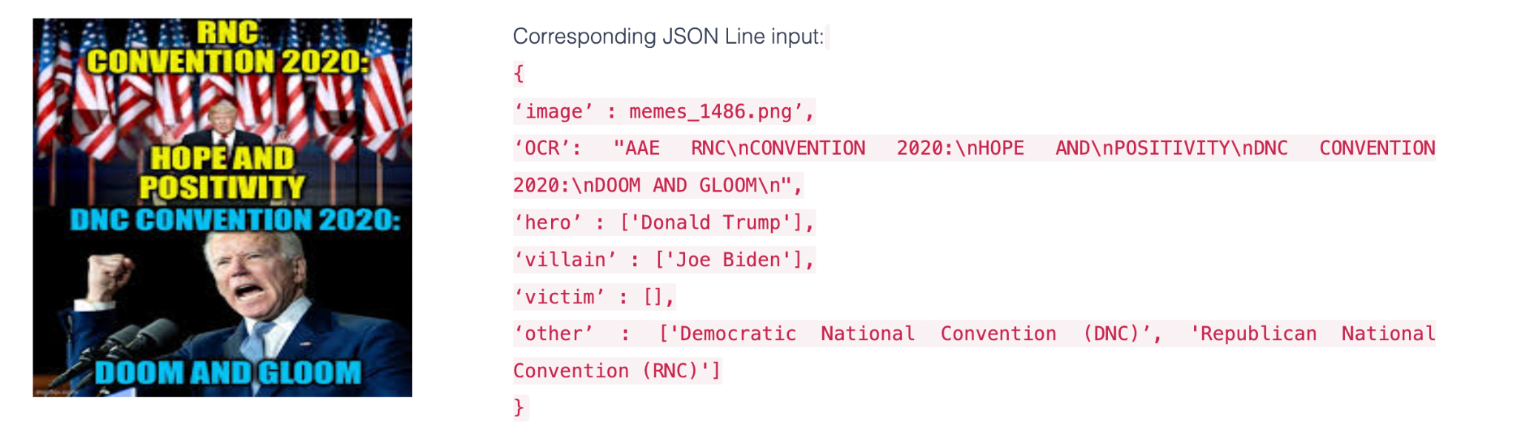
Dataset Details
The task is to categorise an entity into one of the Hero, Villain, Victim, or others given a context which is OCR of the text written on Meme and Image for visual context.
An example of our data would be like:

Slide 4
Dataset Details
The original dataset is merged and each entity present in a datapoint is made into a new datapoint on the basis of role it has.
After doing this step we have approx 17k datapoints but the data is hugely imbalanced with the role of “other” comprising of more than 70% of datapoints.
The images are made text free using Keras functions.
The combined dataset is used for training , validation and testing.

Slide 5
Related Works
Mention and Entity Description : Co-Attention for Entity Disambiguation
Nie et al. have proposed a Context-Entity Co-Attention model that works on textual context provided. Our aim in this project would be to extend the model and use it when the context is multimodal. This model can be further modified to account for the type of the entity and add greater details to the vector generated. General architecture would be to have vector representation of context and entity (using bi-LSTM) act as input. We would generate an attention probability of each vector in context and take the weighted sum of all contextual vectors.

Slide 6
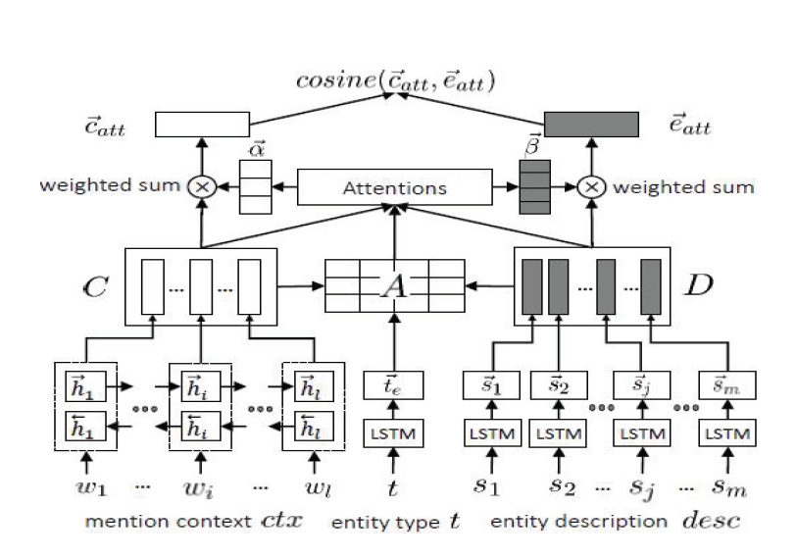
Related Works
Mention and Entity Description : Co-Attention for Entity Disambiguation

Slide 7
Related Works
Bilateral Multi-Perspective Matching for Natural Language Sentences:
Wang et al. shared a multi perspective approach to match all time-steps of a sentence to all time-steps of another sentence. They proposed use of Bi-LSTM encoder, four different matching techniques and finally an LSTM to aggregate the result of all matching techniques. We have used this approach to find attention between context text and entity.

Slide 8
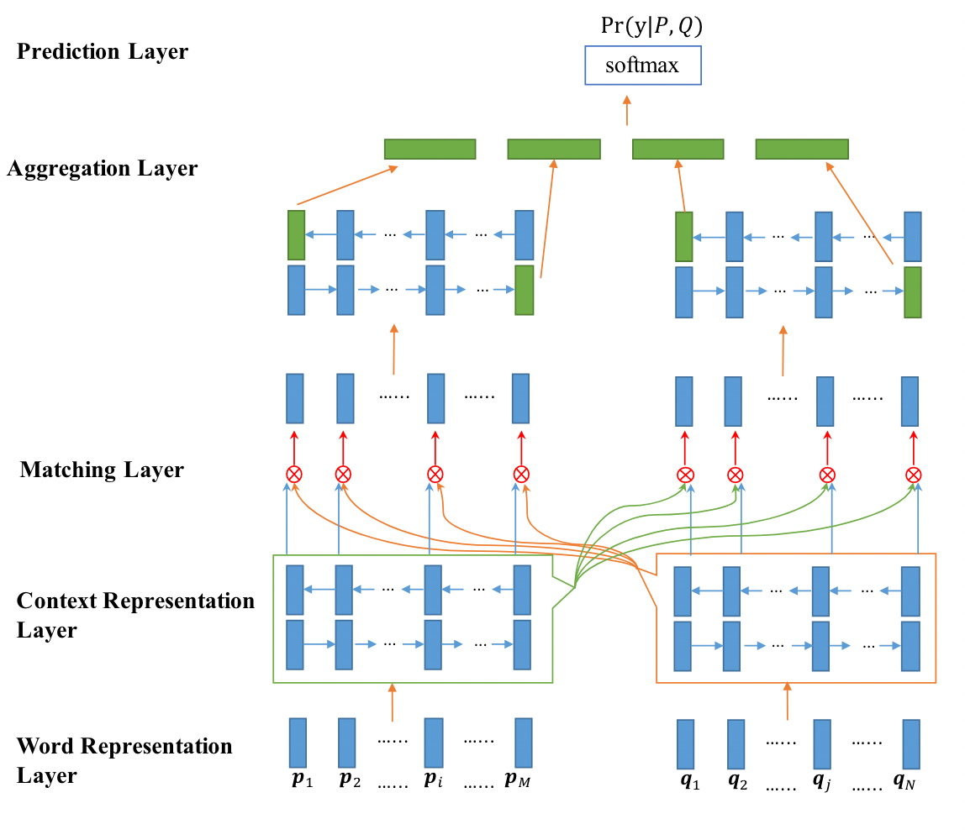
Related Works

Slide 9
Related Works
Entity-sensitive attention and fusion network for entity-level multimodal sentiment classification:
Yu et al. suggested an approach to combine entity, context and visual features into one representation and use multiclass classification on it. The approach focuses on attending context and entity first and then finding visual feature alignment with the context-entity attention.
The approach focuses heavily on finding the left and right context. In our scenario the entity text is missing in the OCR output so we have use BiMPM approach to align the context and entity. We have used Yu et al. approach to extract visual features from the image and combine with context-entity attention.

Slide 10
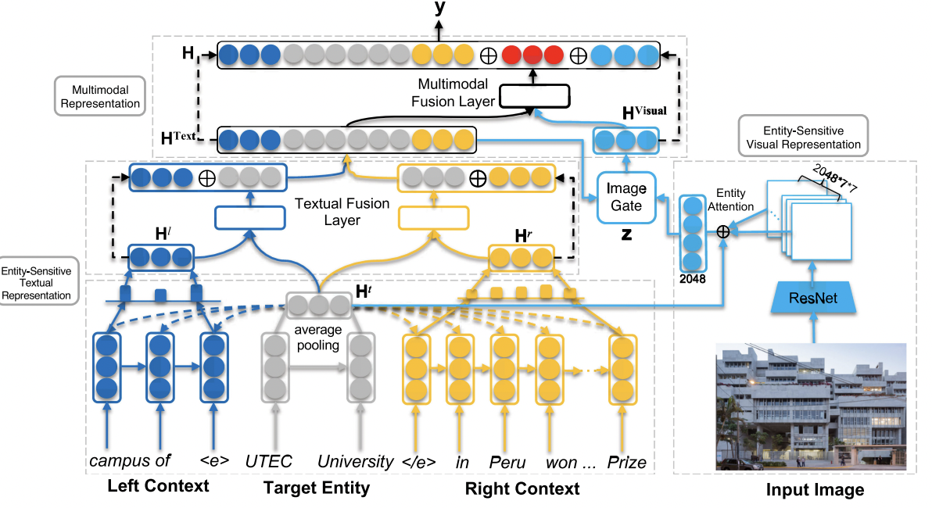
Related Works
Entity-sensitive attention and fusion network for entity-level multimodal sentiment classification:

Slide 11
Methodology
Baseline Network:
We simply use two LSTM and pass the OCR text from one and use the context it generates and pass it as the hidden state to the other LSTM which takes entity as input.
The LSTM has two layers and a dropout of 0.5 is used for the purpose of regularisation.
Visual features are not taken into consideration in this method.
The final output generated by the second LSTM is then passed through a Linear Layer and softmax and cross entropy is used to train the model.
Adam optimizer with weight decay is used to propagate the gradient and prevent model from overfitting.

Slide 12
Methodology
Co-attention Network:
The idea is based on using Mention and Entity Description : Co-Attention for Entity Disambiguation as the attention model for the context and entity.
Visual features are extracted using VGG-16.
The text features are extracted separately for entity and OCR-text and co-attention is applied between entity and ocr-text and image vector and ocr-text.
The co-attention is applied on both the features and the concatenated features are passed through fully connected layer.
Output is computed and BCELoss is used to compute error and AdamW optimizer is used to propagate the gradient.
We have used distilbert for embeddings as well and swapped out Bi-LSTM with transformers as part of implementation of co-attention model.

Slide 13
Methodology
BiMPM-MultiModal Network:
The idea is based on using Bilateral Multi-Perspective Matching for Natural Language Sentences as the attention model for the context and entity.
Visual features are extracted ResNet-152 as described in Entity-sensitive attention and fusion network for entity-level multimodal sentiment classification.
The features are concatenated and passed through a prediction layer consisting of two layer neural network with tanh as activation function and dropout to regularize the network.
Output is sent to sigmoid activation layer and BCELoss is used to compute error and Adam optimizer is used to propagate the gradient.

Slide 14
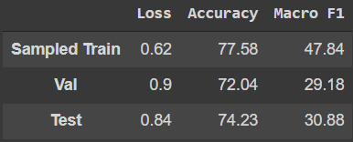
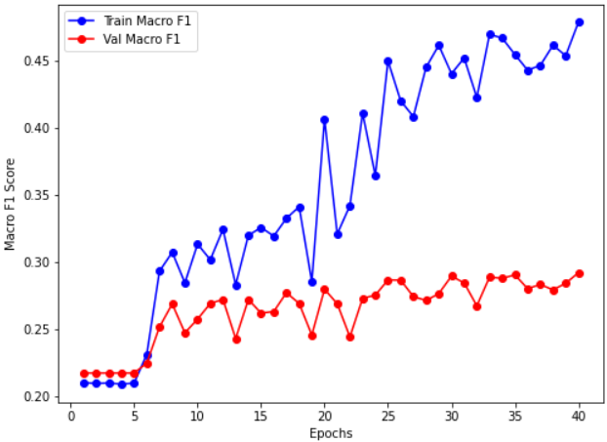
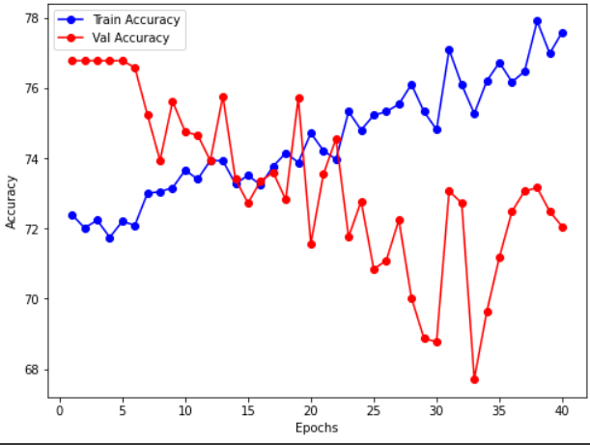
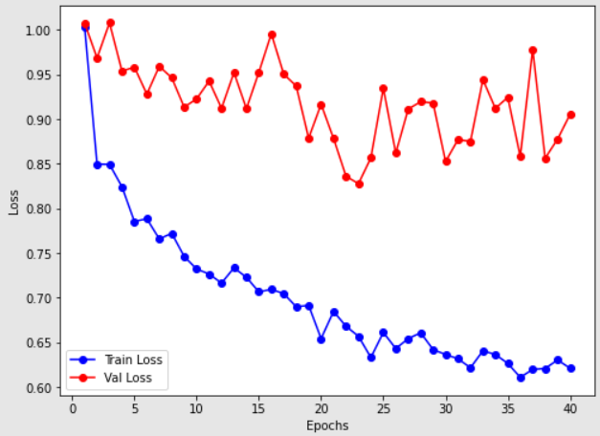
Results/Analysis
Baseline Model

Slide 15
Results/Analysis
Baseline Network:
The train results are so high because the model is trained on a sampled network of 9k out of 17k data points to maintain the class balance.
We are achieving similar results are on validation and test set, which indicates the model is generalized enough to accommodate for unseen examples and produce similar results.
We are able to achieve macro F1 on both val and test which is around 30%.
The model although being simple is still able to learn complex details present in the dataset and can produce more better results if trained properly for more epochs.

Slide 16
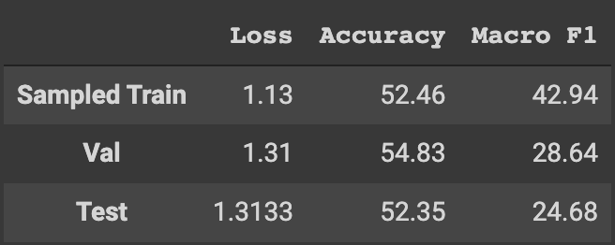
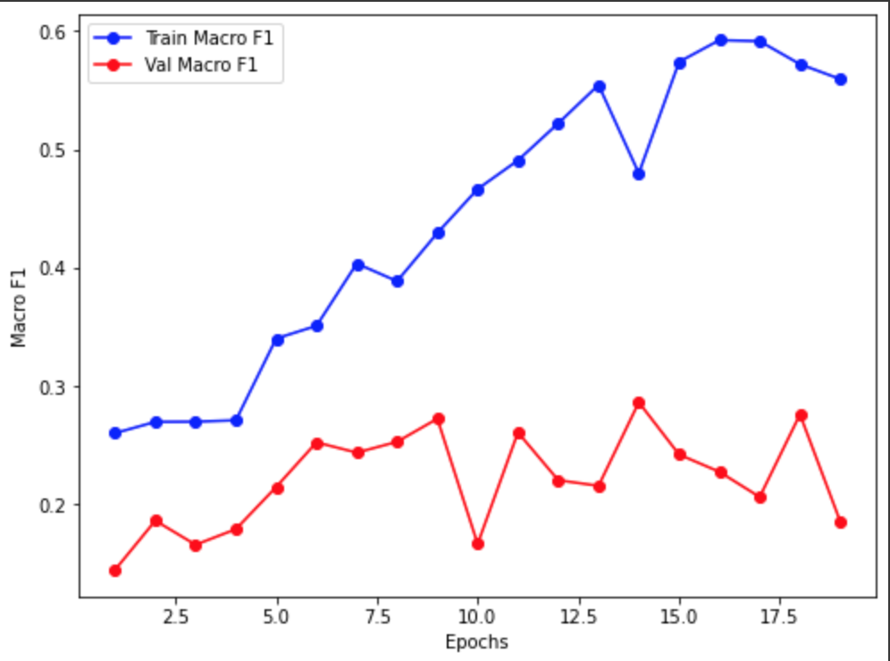
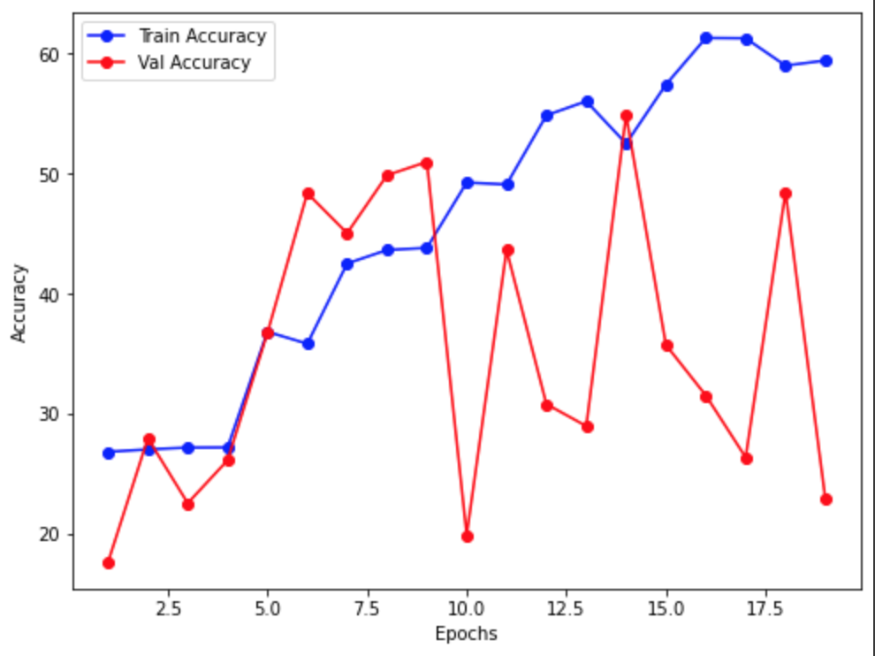
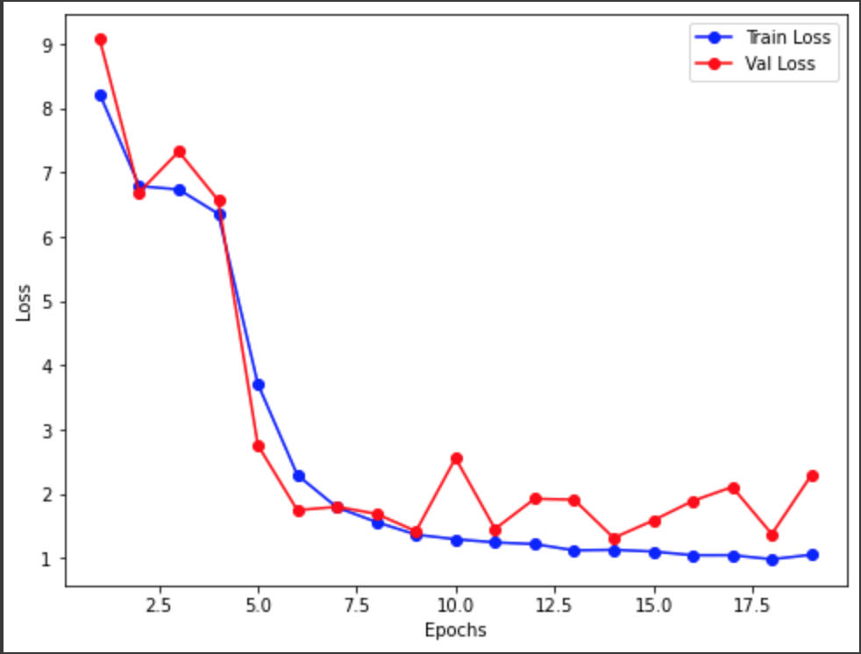
Results/Analysis
Co-attention model w/ glove embedding

Slide 17
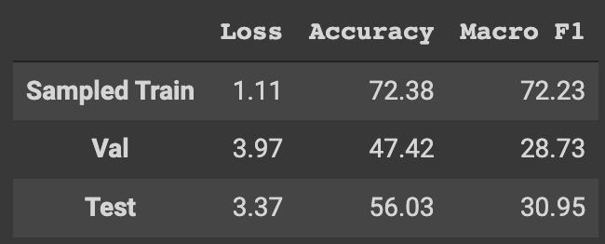
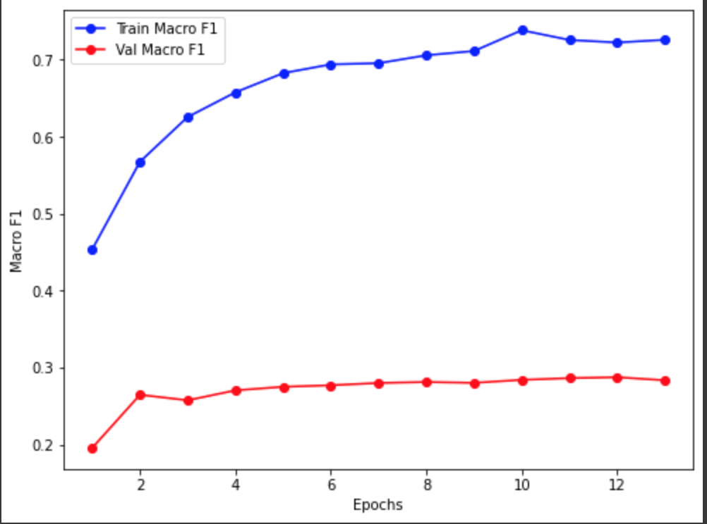
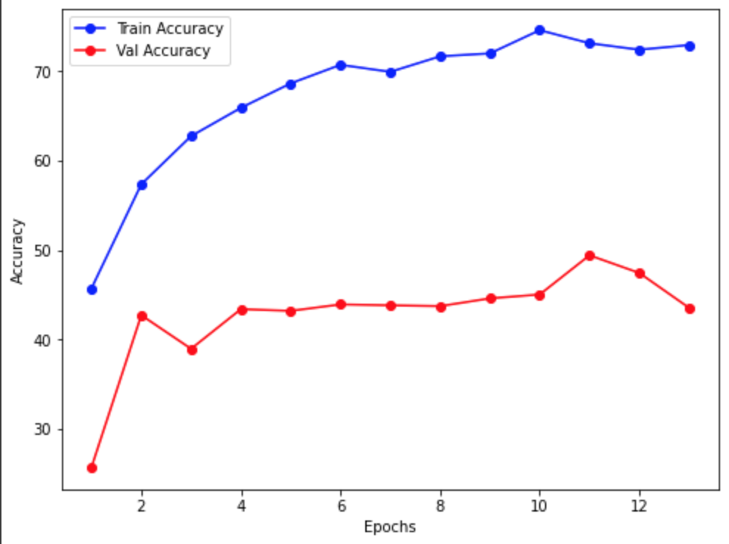
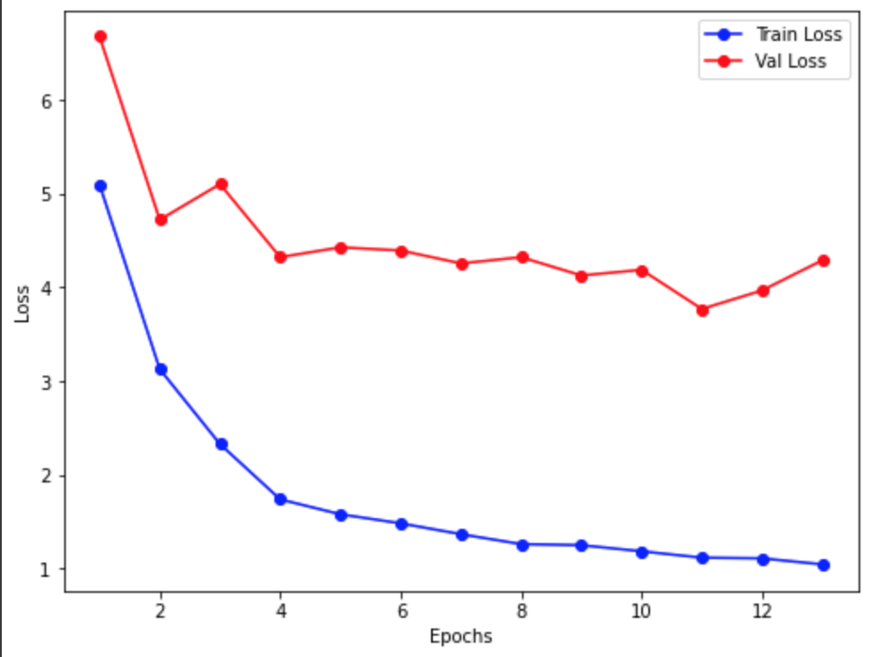
Results/Analysis
Co-attention model w/ distilbert embedding

Slide 18
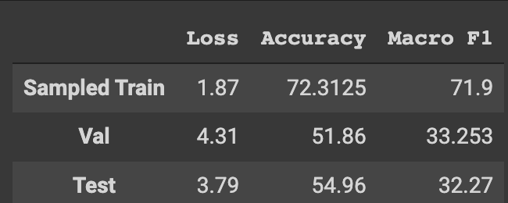
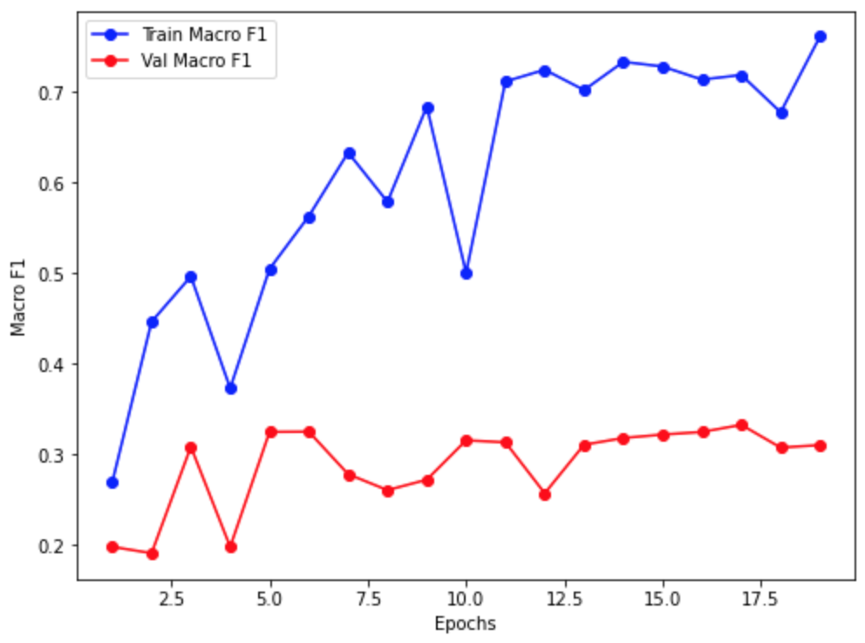
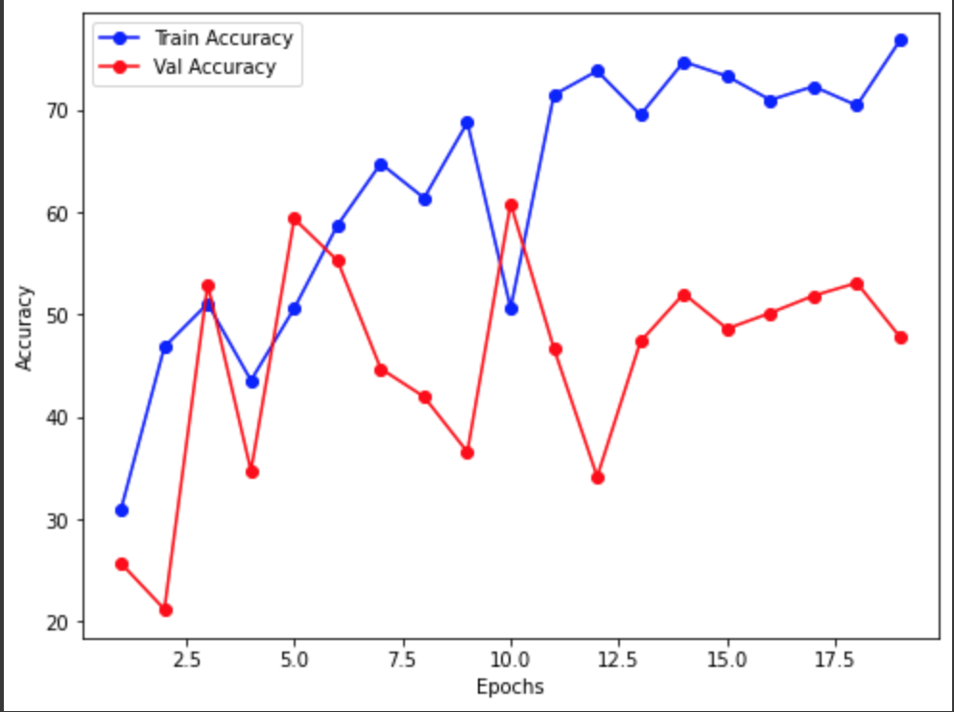
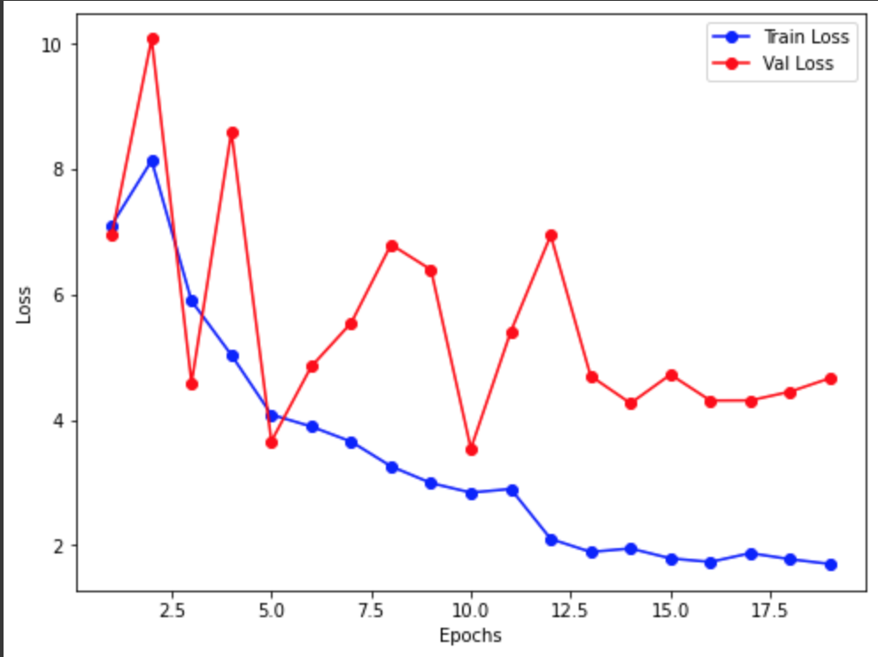
Results/Analysis
Co-attention model w/ transformer

Slide 19
Results/Analysis
Co-attention Networks:
The train results are so high because the model is trained on a sampled network of 9k out of 17k data points to maintain the class balance.
We are achieving similar results are on validation and test set, which indicates the model is generalized enough to accommodate for unseen examples and produce similar results.
We are able to achieve macro F1 on both val and test which is around 33% for Co-attention with transformer.
The model although being simple is still able to learn complex details present in the dataset and can produce more better results if trained properly for more epochs.

Slide 20
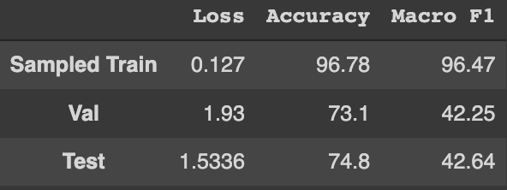
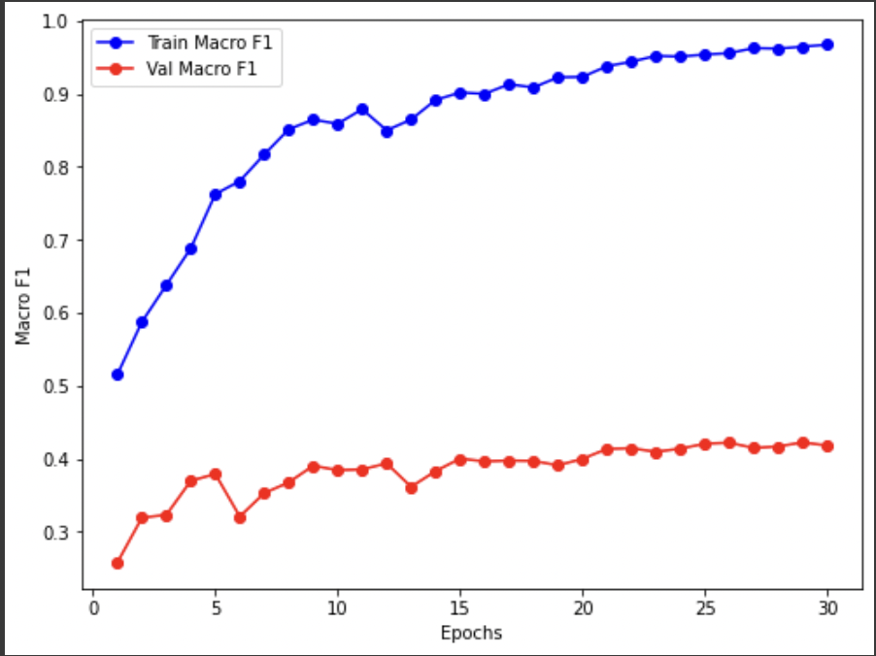
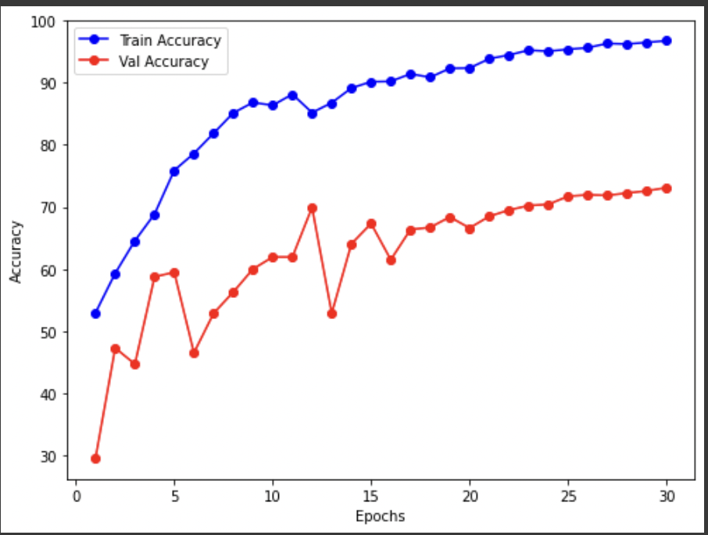
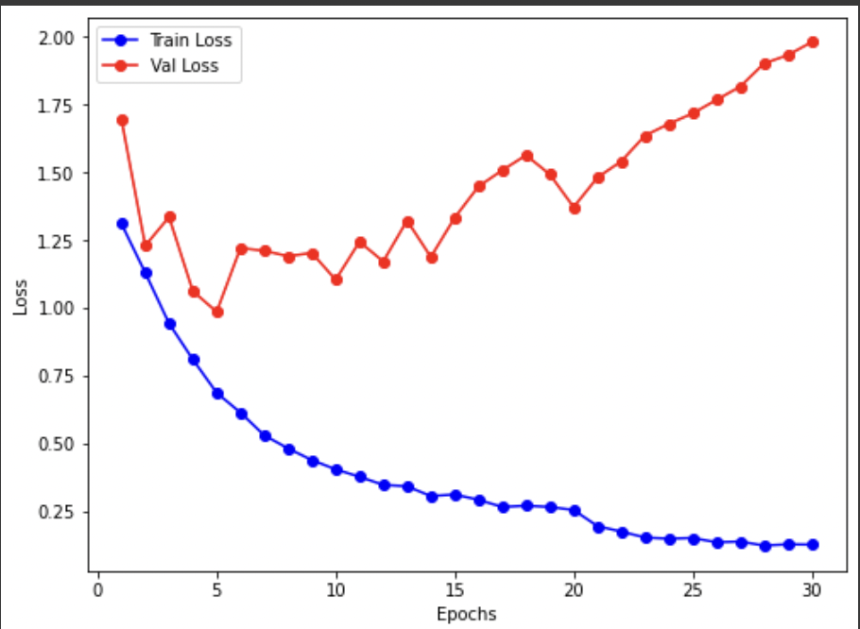
Results/Analysis
BiMPM-MultiModal Network

Slide 21
Results/Analysis
BiMPM-MultiModal Network:
In the first 50 epochs, we have updated the discriminator on the fourth epoch
We are achieving similar results are on validation and test set, which indicates the model is generalized enough to accommodate for unseen examples and produce similar results.
We are able to achieve our highest macro F1 on both val and test which is around 42%.
The model can be made more accurate by giving it more training time with increasing number of samples when overfit is observed and adding more weight decay and with lower learning rate.

Slide 22
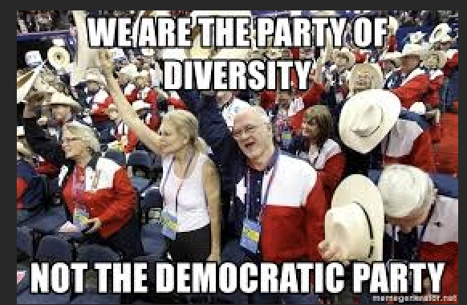
Challenges
Out of 17528 entity list(on combining politics and Covid 19 dataset), almost 13713 i.e. 78.2 % belong to others.
Highly unbalanced training data makes the task of training difficult.
OCR text generation on the images is poor due to which overall performance suffers.
Entity is not always a part of the context(OCR) generated
{"OCR": "WE ARE THE PARTY OF\nDIVERSITY\nNOT THE DEMOCRATIC PARTY\nmetagarkaler.nat\n", "image": "memes_1492.png", "hero": ["republican party"], "villain": ["democratic party"], "victim": [], "other": []}

Slide 23
Contribution
Harsh Vardhan - Preprocessing, BiMPM-MultiModal Model, Co-attention Network
Hanzalah Firdausi - Preprocessing, Baseline Model, Co-attention Network
Shreyansh Jain - Preprocessing, Co-attention Network, Glove and Distilber Embedding, Transformer

